Slide 1
Know how to generate standard data analysis figures in base Matlab
Briefly demonstrate Figure editor
Basic understanding of how to use Matlab handles to create modifications to Figures/plots
Access and modify a Figure’s properties using handles dot notation

Slide 2
graphic object - components used to visualize data
figure - a programmable window to which you can add graphic objects such as axes or ui objects
axes - a plotting object where you can add plots or images
handle - an object identifier. Every figure, axis, and control element has a handle
properties - the properties of an object like a figure or an axis

Slide 3
Important Terminology
Figure
Properties:
Color
LineWidth
Background Color
Title
Size
Axes
Graphing Object
Graphing Object
Handles:

Slide 4
Handle property rules (REVIEW)
Graphics Name Value Pairs
As of 2014b Graphics handles behave like other Matlab objects
h = plot(1:10);
h.LineWidth = 2;
object.PropertyName = PropertyValue

Slide 5
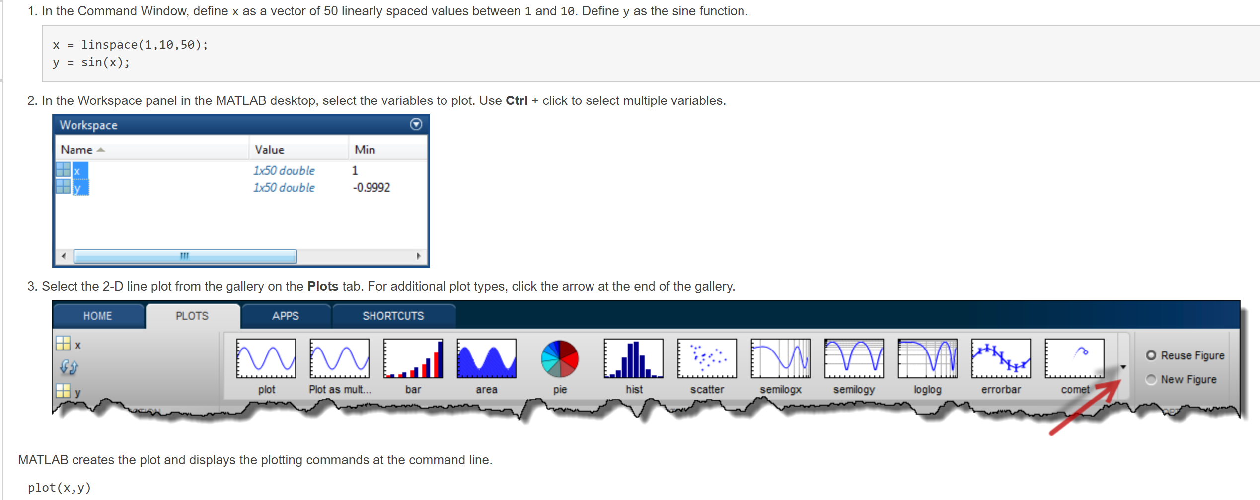
GUI-based figure generation

Slide 6
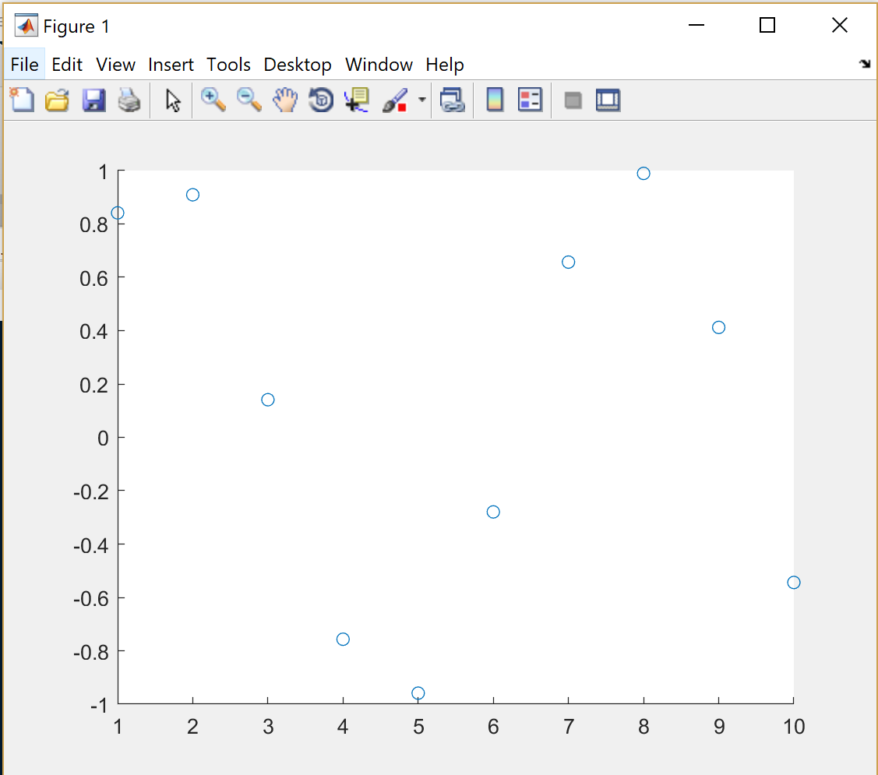
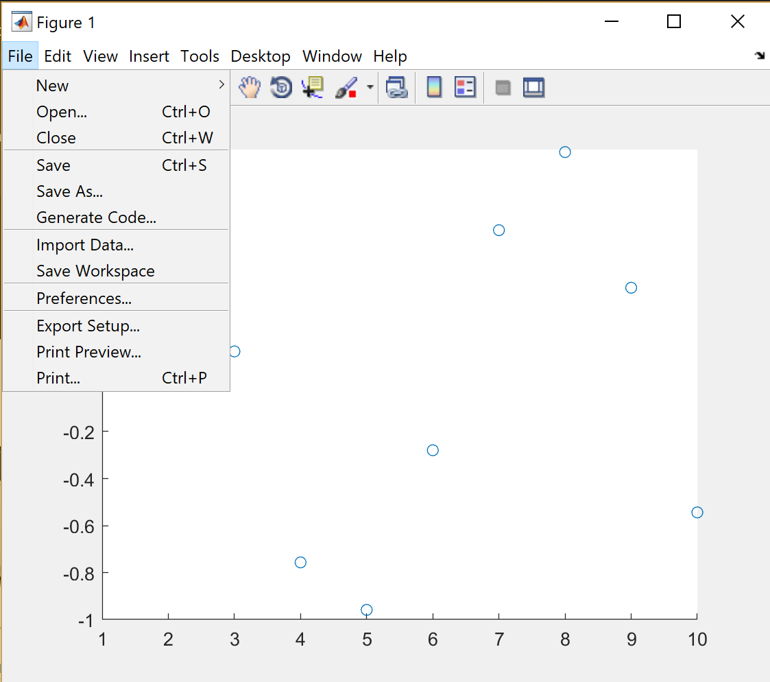
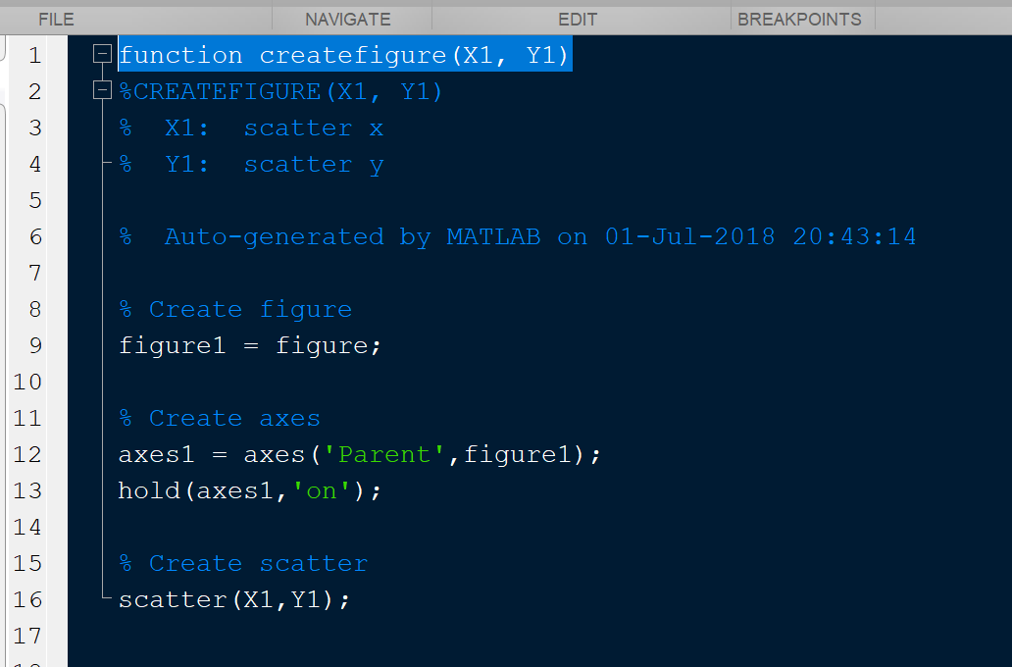

Slide 7
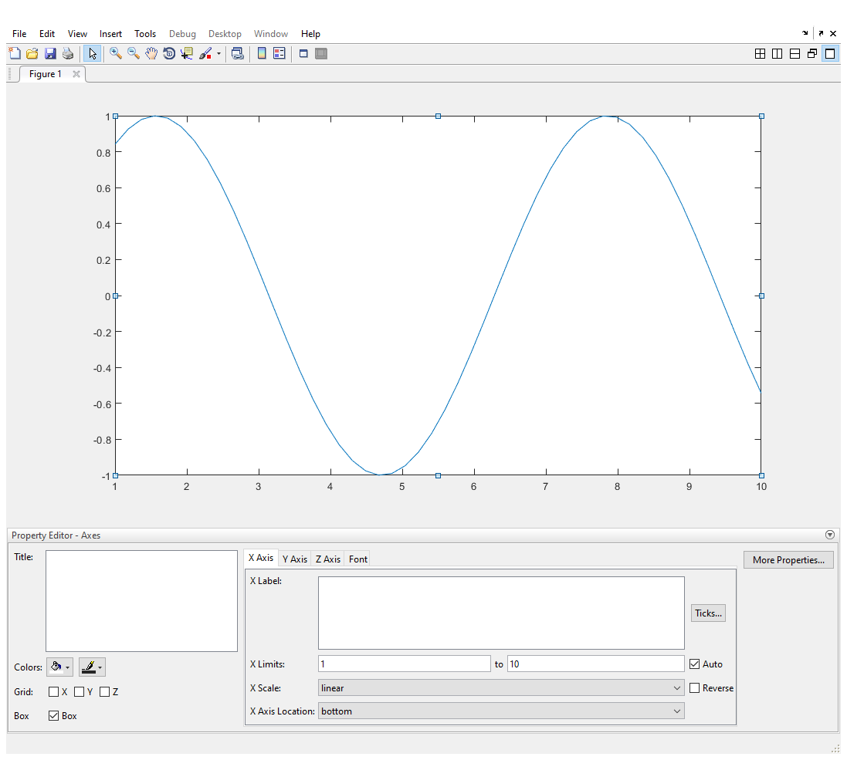
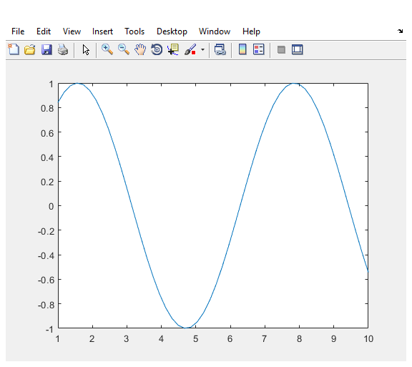
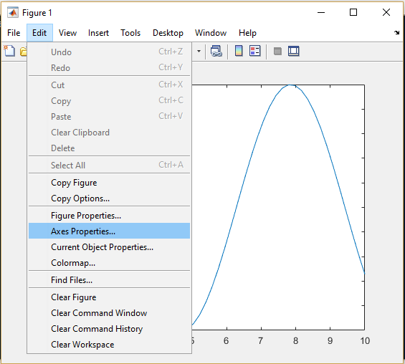
GUI-based figure modification
Manual modification:
Plot elements
Axis elements
Legend
Etc.

Slide 8
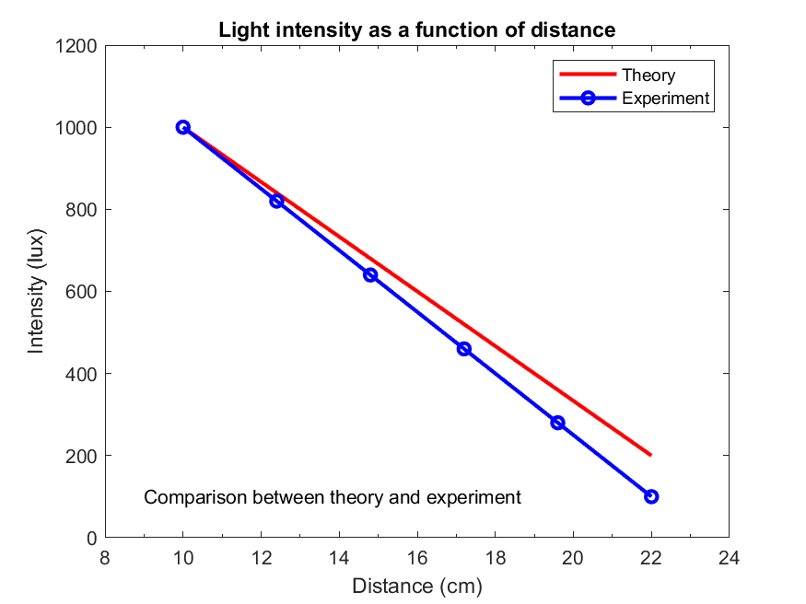
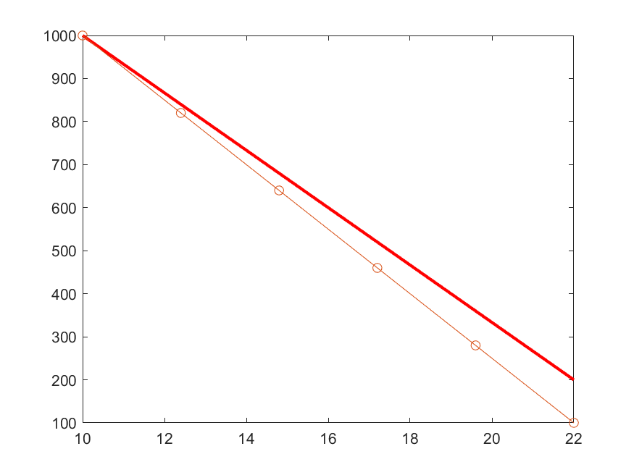

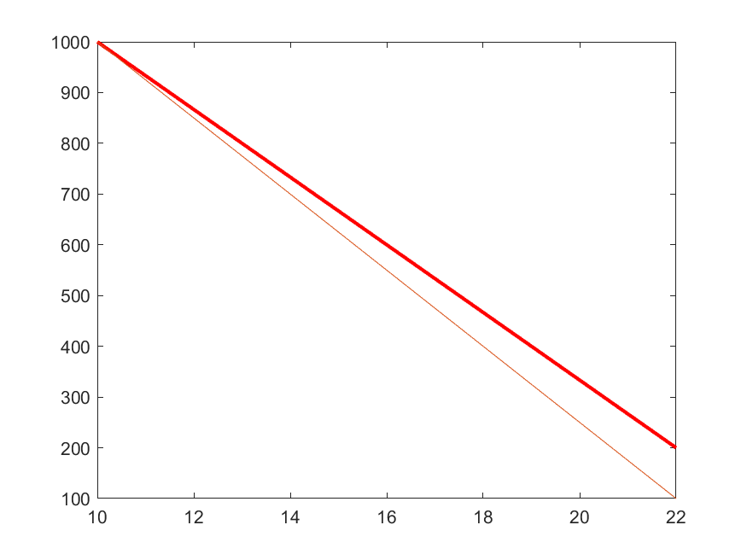
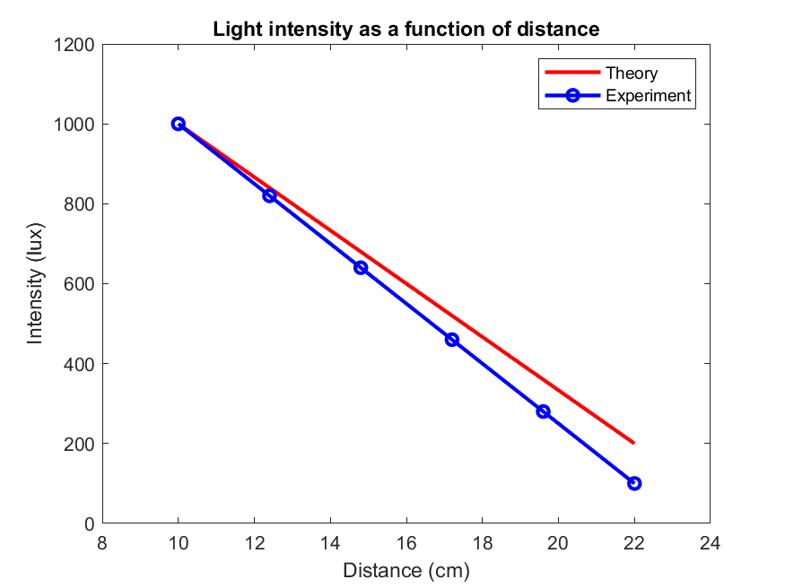
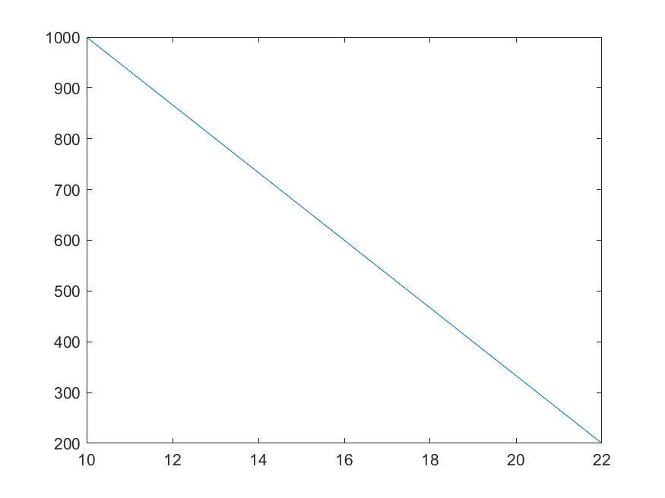
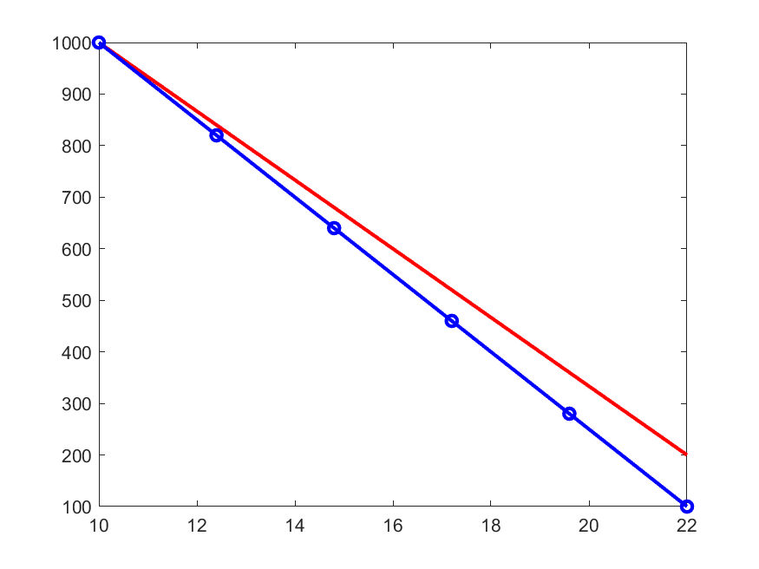
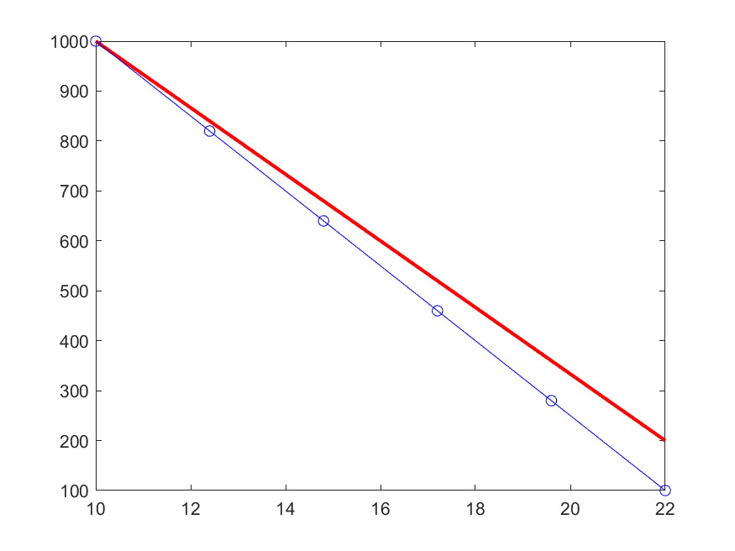
Anatomy of 2D Figure
p1 = plot(x,y)
Using handles for objects to
change properties
Plot elements

Slide 9
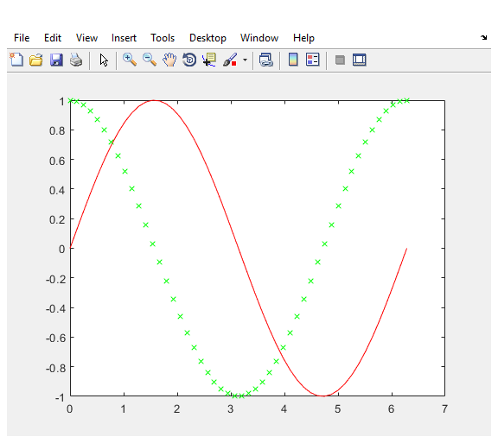
Multiple paths lead to same endpoint
x = linspace(0,2*pi,50)
y = sin(x)
z = cos(x)
Option 1
plot(x,y,'r',x,z,'gx')
Option 2
plot(x,y,’r’)
hold on
plot(x,z,’gx’)
Option 3
line(x,y,’Color’,’r’)
hold on
scatter(x,y,30,’g’,’x’)

Slide 10
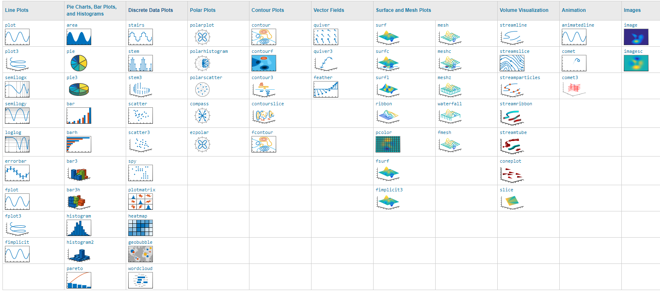
General purpose vs. special purpose
Mix and match

Slide 11
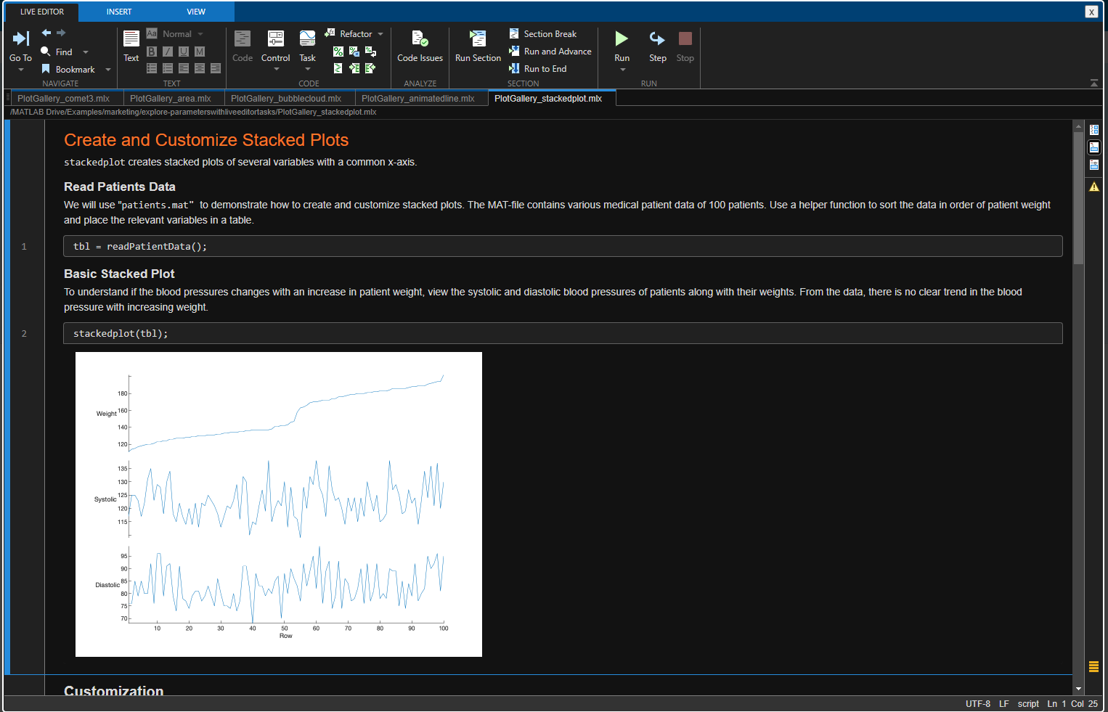
https://www.mathworks.com/products/matlab/plot-gallery.html

Slide 12
Live Scripts for today
BasicPlotBuild.mlx
CommonVisualizations.mlx
UnCommonPlots.mlx

